Slide 1
Greek and Latin Roots Common Pre-fixes

Slide 2
What are roots?
An English word can consist of three parts: the root, a prefix and a suffix. The root is the part of the word that contains the basic meaning (definition) of the word. The root is the base element of the word.
Many roots to English words come from Greek or Latin words. Knowing Greek and Latin roots can help you figure out the meaning of words you don’t already know.

Slide 3
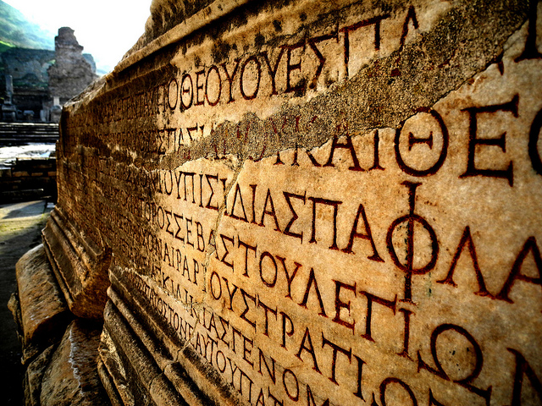
Common Greek
Roots

Slide 4
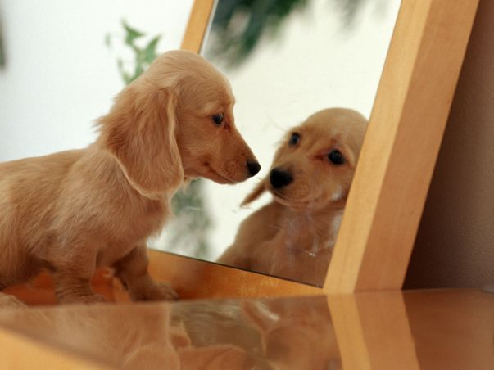
auto
autobiography
automatic
automobile
= self

Slide 5
bio
biology
biography
biome
= life, living

Slide 6
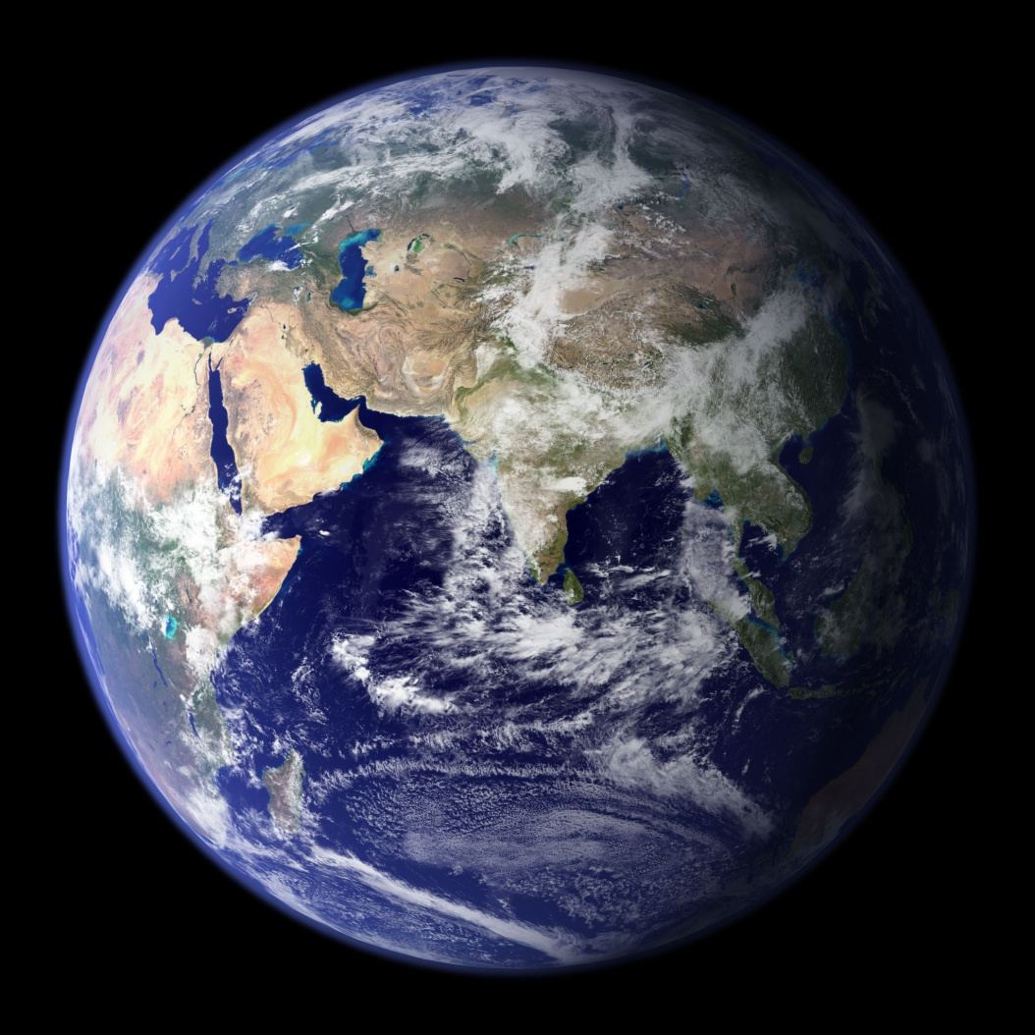
geo
geography
geology
= life, living

Slide 7
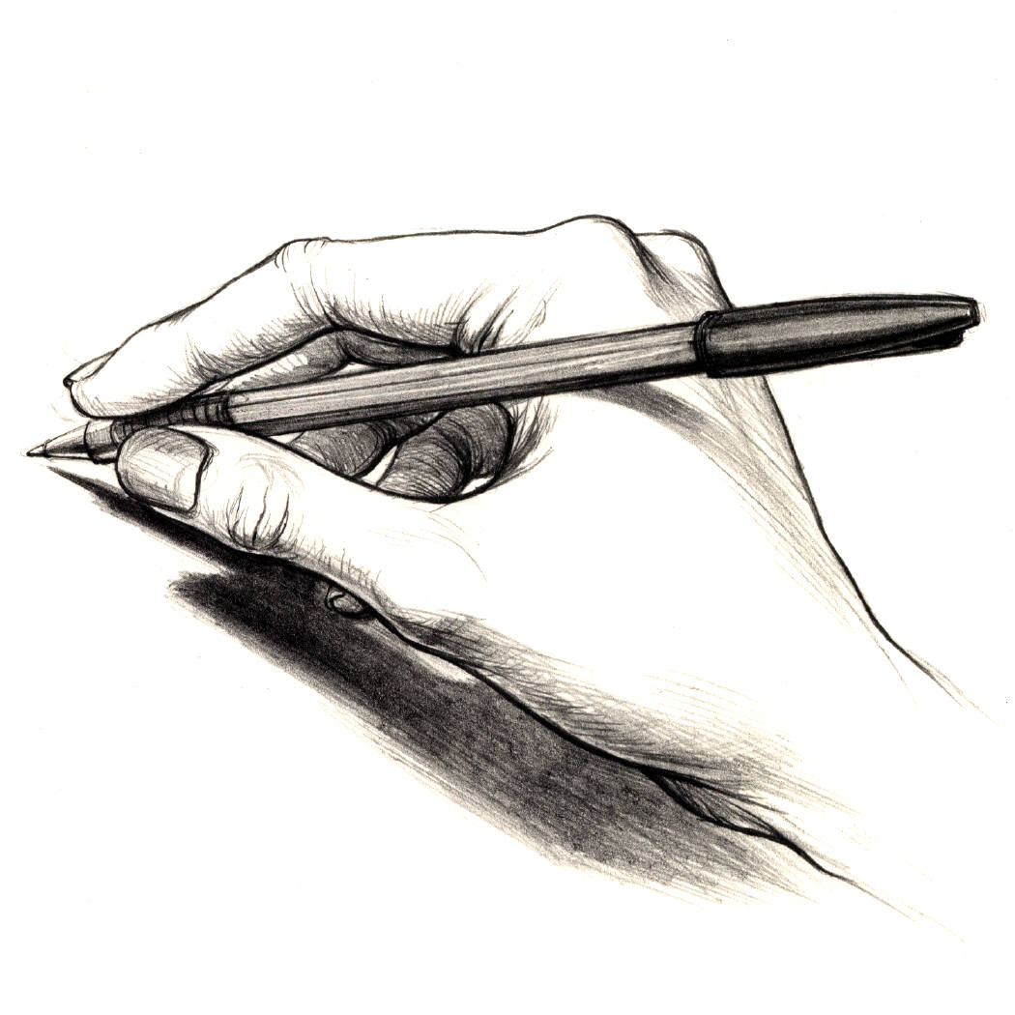
graph
autograph
biography
= write

Slide 8
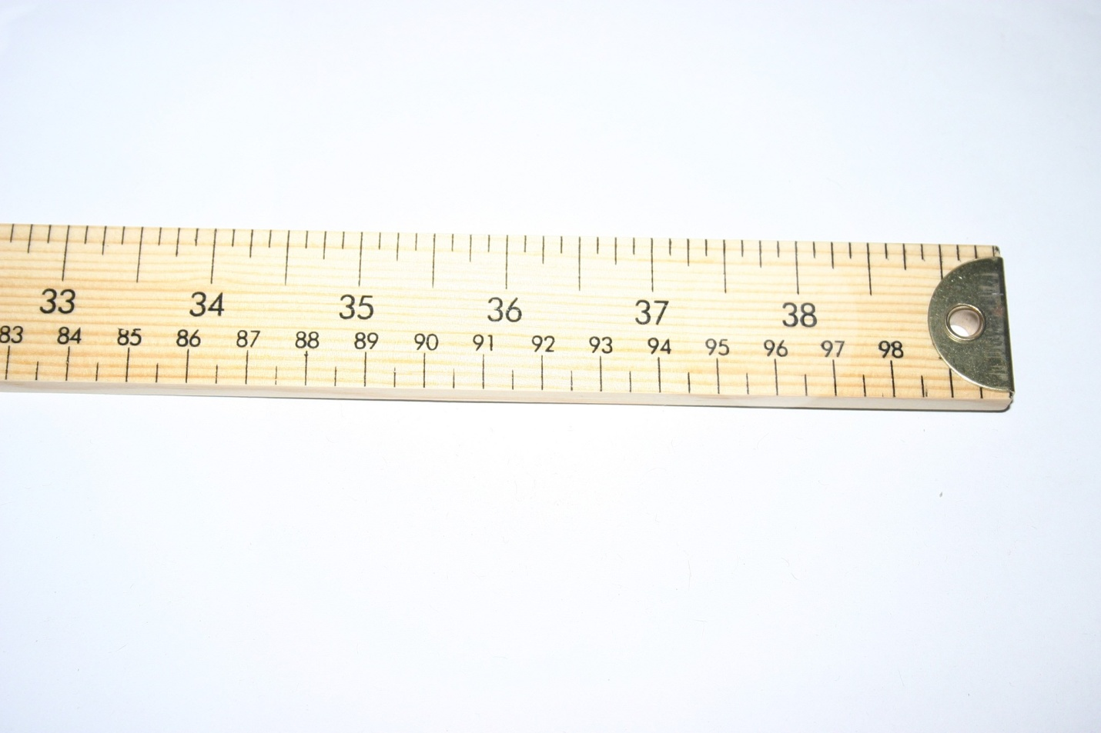
meter
meter (length)
kilometer
centimeter
= measure

Slide 9
phil
philosophy
bibliophile
= love

Slide 10
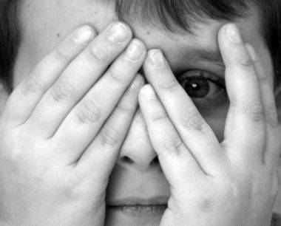
phobe
phobia
arachnophobia
claustrophobia
= fear

Slide 11
photo
photograph
photosynthesis
= light

Slide 12
phon
telephone
phonics
phonograph
= sound

Slide 13
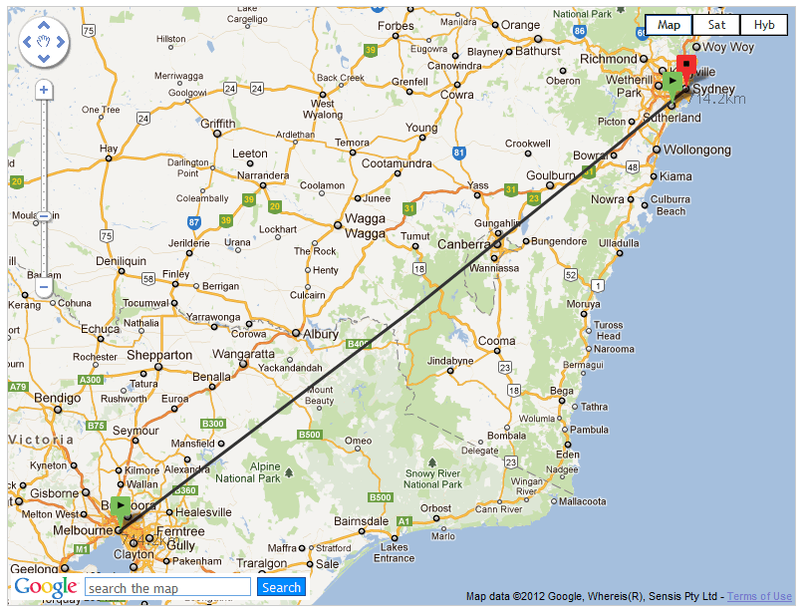
tele
telephone
television
telescope
teleport
= distance

Slide 14
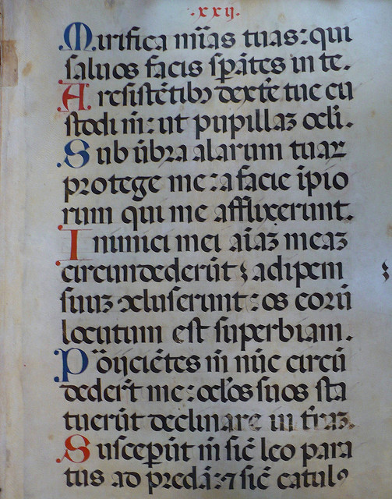
Common Latin
Roots

Slide 15
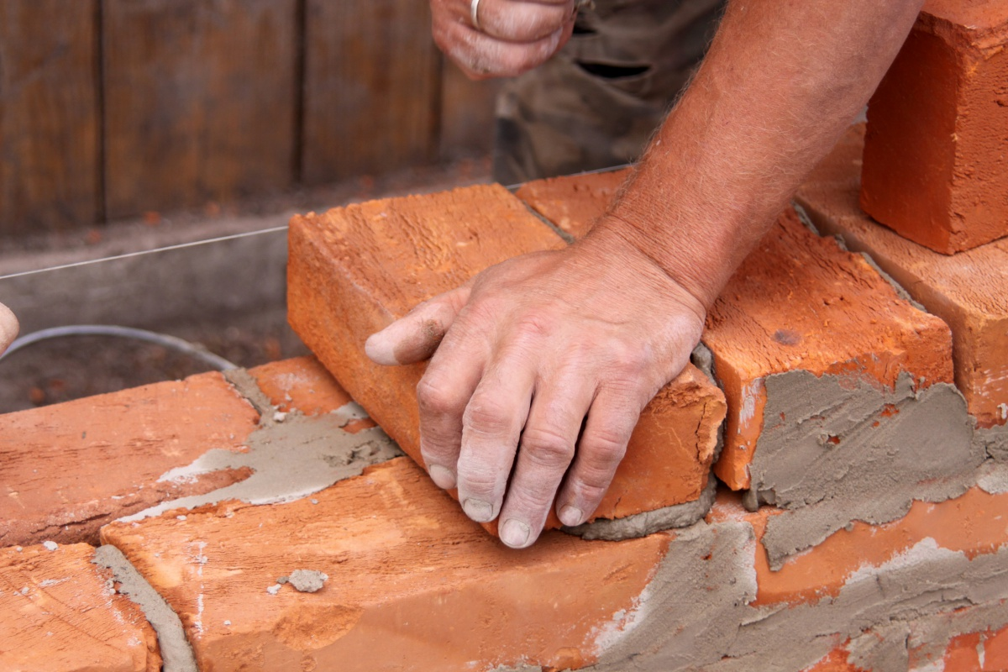
act
react
action
actor
= do

Slide 16
aud
audio
aural
audience
= hear

Slide 17
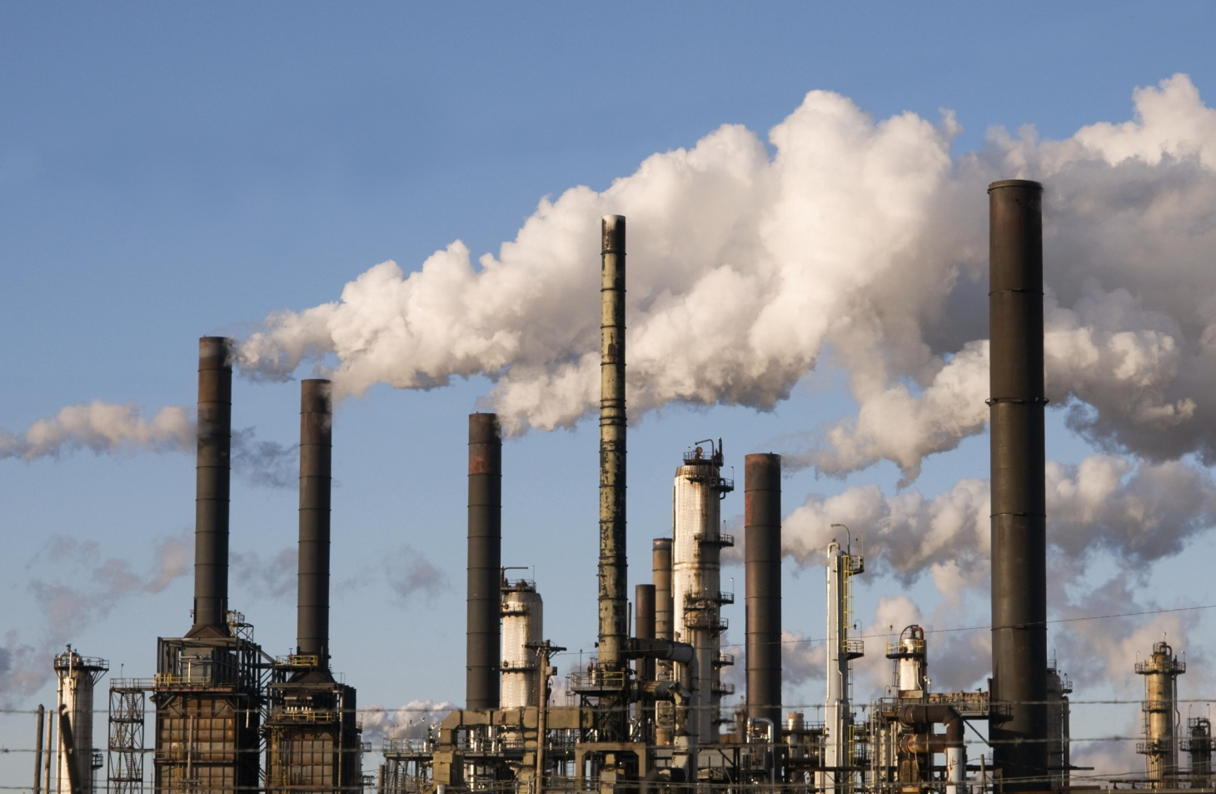
fac
facilitate
manufacture
factory
= make, do

Slide 18
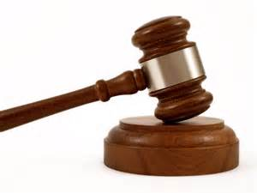
jur / jus
jury
justice
jurisdiction
= law

Slide 19
loc
location
allocate
relocate
= place

Slide 20
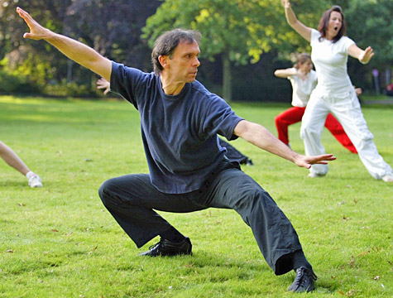
mob
mobility
automobile
= move

Slide 21
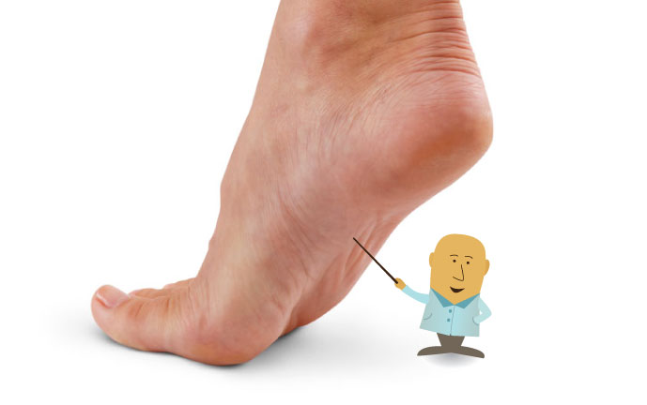
ped
pedals
pedestrian
= foot

Slide 22
sign
signature
signal
signify
= mark

Slide 23
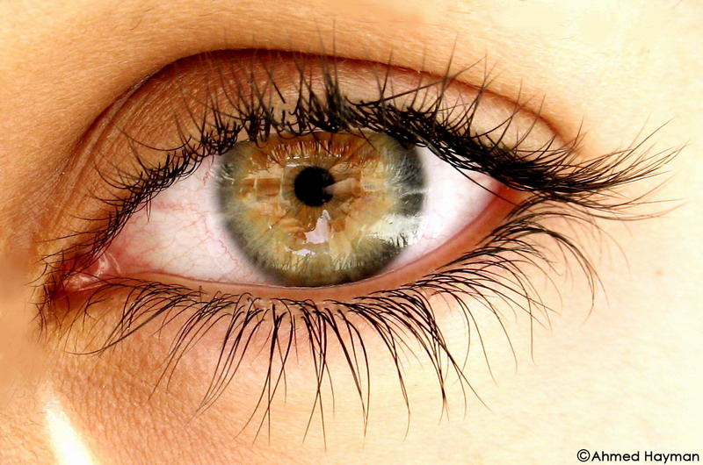
spec
spectacles (glasses)
spectacle (show)
spectator
= see

Slide 24
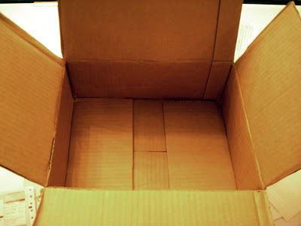
vac
vacant
evacuate
vacuum
= empty

Slide 25
What are pre-fixes?
Prefixes are word parts that you add to the beginning of the root or base word. Prefixes can change the meaning of a word.

Slide 26
Common
Pre-fixes

Slide 27
anti- or contra-
= against
Examples:
antisocial
contradict

Slide 28
cent-
= hundred
Examples:
centimeter
century

Slide 29
ex-
= out
Examples:
exit
exile
excommunicate

Slide 30
ir- or in- or im-
= not
Examples:
irregular (ir- + regular)
inconvenient (in- + convenient)
imperfect (im + perfect)

Slide 31
non-
= not
Examples:
nonverbal
nonsense

Slide 32
post-
= after
Examples:
postpone
post-workout

Slide 33
pre-
= before
Examples:
prepare
preview
pre-workout

Slide 34
pro-
= forward
Examples:
progress
proactive
product

Slide 35
re-
= again
Examples:
reappear
reply
redo

Slide 36
un-
= not
Examples:
undone
uncooked
unhinged

